Slide 1

AgroTech
Smart Farming,
Better Future
Presented By
Muaaz Bin Mukhtar FA21-BSE-045
Muhammad Moiz FA21-BSE-044
Ammar Ali FA21-BSE-042
Supervised By
Ms. Saira Beg
Notes:
Asslamualikum, I am Muaaz Bin Mukhtar. With me is Mohammad Ammar Ali and Muhammad Moiz. We have proposed a system "AgroTech" for our final year project under the supervision of Mam Saira Beg.

Slide 2

Introduction
AgroTech is a web-based platform that modernizes agriculture using AI, ML, and image processing. It offers farmers, sellers, and customers tools like crop recommendations and monitoring, soil and climate analysis, and an AI-powered chatbot for support. The platform also features a marketplace to connect farmers with buyers, enhancing market access and profitability. By streamlining the agricultural process—from planting to harvesting to marketing—AgroTech enables data-driven decisions, boosting crop yield and sustainability, while addressing inefficiencies in traditional farming practices.
Notes:
AgroTech is a web-based platform designed to revolutionize the agricultural industry as it is the backbone of our economy. AgroTech will be equipped with the latest technologies such as ML, AI, Image generation. AgroTech aims to provide assistance to users throughout the lifecycle of a crop. That is from recommending a crop to monitoring it. Then from harvesting it to selling it. It also provides data driven insights to users to help make informed decisions ultimately improving crop quality and quantity. The purpose of this system is to address the inefficiencies that exist in traditional farming practices and empower users with the technology needed to thrive nowadays.

Slide 3
Problem Statement
Resource Wastage and Low Yield
Inefficient crop production and resource management.
Labor-Intensive Traditional Methods
Outdated, manual processes increase effort and inefficiency.
Lack of Data for Decision-Making
Limited access to data affects crop and farming decisions.
Delayed Issue Detection
Late detection of diseases and pests lowers yield and raises costs.
Limited Market Access
Farmers struggle to sell produce; customers face difficulty finding affordable options.
Notes:
These are the problems faced by traditional farming practices.
The first of them is resource wastage and low yield. Poor resource management causes wastage leading to lower crop quantity. Which in result increases expenditure and lowers the profit.
Next is labor intensive traditional methods. Most farmers still rely on old practices, which require manual processes and more man power. This leads to an increase in effort resulting in inefficiency in daily tasks and hence quality.
Another major issue is poor decision making. Farmers often don't have access to information they need to make data-driven decisions about their crops and farming practices. Which results in limited productivity.
There's also poor disease detection. Diseases and pests are often detected too late, due to manual surveillance. Which results in decreased yields and higher mitigation costs.
Another issue is the marketplace. Farmers face limited market access due to middlemen, making it difficult to sell products while customers struggle to find consistent and affordable prices.

Slide 4
Problem Solution
Optimized Resource Management
Data-driven crop and resource recommendations for better yield.
Automated Processes
Advanced tools reduce labor and improve efficiency.
Predictive Analytics
Real-time data and analytics guide smarter decisions.
Early Issue Detection
Monitors crop health, detecting issues early for timely solutions.
Enhanced Market Access
Connects farmers to markets and helps customers find affordable produce.
4o
Notes:
To address these issues, AgroTech provides the following solutions.
Firstly, it will provide optimized resource management and data-driven recommendations to maximize resource optimization. Which results in higher yields and hence higher profits.
Secondly, it will recommend the best practices maximizing the automation in farming processes. Which leads to improved efficiency resulting in quality crops.
AgroTech will use predictive analysis, providing real-time data and insights that will guide farmers in making smart and effective decisions.
We prioritize early disease detection, AgroTech will provide periodic monitoring allowing farmers to detect diseases and pests in early stages.
Finally, AgroTech will provide access to a marketplace, connecting farmers directly to the market and customers. Farmers will be able to sell their products easily. At the same time, customers can benefit by finding affordable and locally sourced options.

Slide 5
Modules
Crop Recommendation
Soil Analysis
Climate Analysis
AgroTech Chatbot
Crop Health Monitoring
Yield Estimation
Crop Maturity Assessment
Harvesting Assist
Transport Assist
Storage Assist
Online Marketplace
Reports & Analytics
Notes:
Following are the modules for AgroTech.
It will analyze soil based on the result of soil testing. That is nutrient testing, acidity testing, salinity testing. It can also use previous soil records for better analysis.
It will assess the current seasonal weather, temperature and humidity of the area. It can also get online weather reports by fetching location.
Based on soil and climate analysis, AgroTech will provide crop recommendations suitable for the conditions. It will give pros and cons for all the options and farmers can select any of them according to his suitability.
AgroTech will be equipped with an AI based chatbot, which will provide knowledge and help solve farmer queries and problems.
AgroTech will schedule periodic monitoring of crops. It will detect diseases and pests early on ensuring the best health of crops. It will provide assistance on usage of pesticides and medicines.
It will also provide yield estimation based on the health of crops and environment. That is soil and climate analysis. It will assist in optimizing resources and plans.
Using image recognition, AgroTech tells the maturity of crops and when will be the crops ready to harvest.
‌It will also design optimized schedules for harvesting. And recommend tools and techniques for harvesting. It will also allow farmers to rent or buy tools through the platform.
‌The system will also be integrated with transportation assist. Which will provide recommendations, pickup, packaging and drop-off facilities in minimum expenditure.
‌The system will also be integrated with storage assist. Which will recommend storage types, temperatures and locations. Users can also book suitable storage places through the system. It will also help users in quality grading of crops.
‌The system will provide access to a marketplace where the farmer can list his product with all the necessary information. If a farmer needs to sell in bulk, he will also be able to perform bidding. Customers will be able to view, review and buy products.
‌The system will generate reports for comparative analysis, system performance, sales and revenues etc.

Slide 6
Actors
Admin
Farmers
Manages platform settings, user access, and system functionalities.
Oversees the addition and update of crop recommendations, soil analysis algorithms, and marketplace features.
Monitors system performance and ensures seamless operation, addressing any technical issues that arise.
Receives tailored crop recommendations based on soil and climate analysis.
Uses the platform to access expert advice via the AI-powered chatbot for real-time guidance.
Lists products on the marketplace, directly connecting with buyers to sell crops and produce.
Customers
Sellers
Uses the marketplace to buy fresh produce directly from farmers.
Can browse and compare products based on pricing, quality, and location.
Receives recommendations for seasonal produce and optimal buying choices based on regional availability.
Purchases crops and produce directly from farmers through the marketplace.
Can filter available products based on region, crop type, or quantity.
Accesses detailed information on product quality, pricing, and availability to make informed purchasing decisions.
Notes:
Our system is for 4 types of users.
Admin holds the highest level of authority. He can view, edit, add, and delete anything at any time. He can view reports and manage user complaints.
‌Farmers can perform soil and climate analysis, get crop recommendations and monitoring. They can access the transport and storage assist and can also grade their products using the system.
‌Sellers can list their products with required details. It can be a farmer selling crops or any other person selling/renting tools or pesticides etc. Sellers can view reports to analyze their sales and can also feature any product.
‌Customers can view, review and buy the listed products.

Slide 7
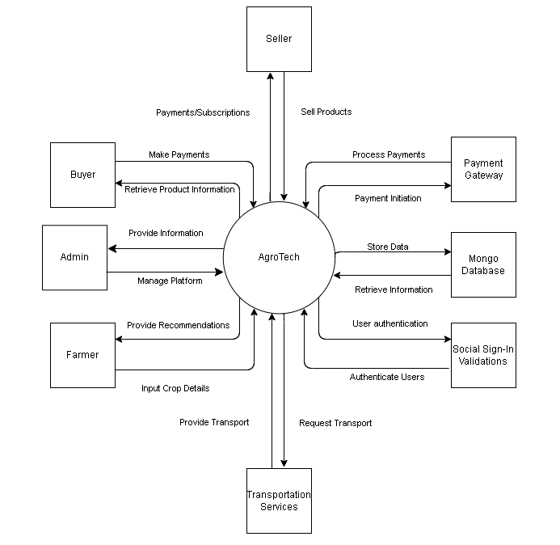
Context Diagram

Slide 8
Major Use Cases
Admin
Farmers
User Management
System Monitoring
Data Management
Soil Analysis
Crop Maturity Assessment
Chatbot Interaction
Customers
Sellers
Browse and Purchase Products
Order Tracking
Feedback and Reviews
Product Listing
Order Management
Pricing and Availability

Slide 9
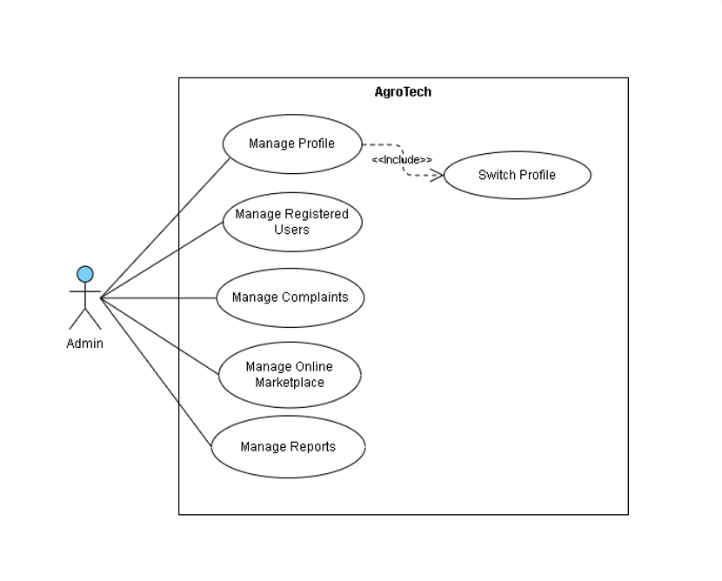
Admin Use-Case

Slide 10
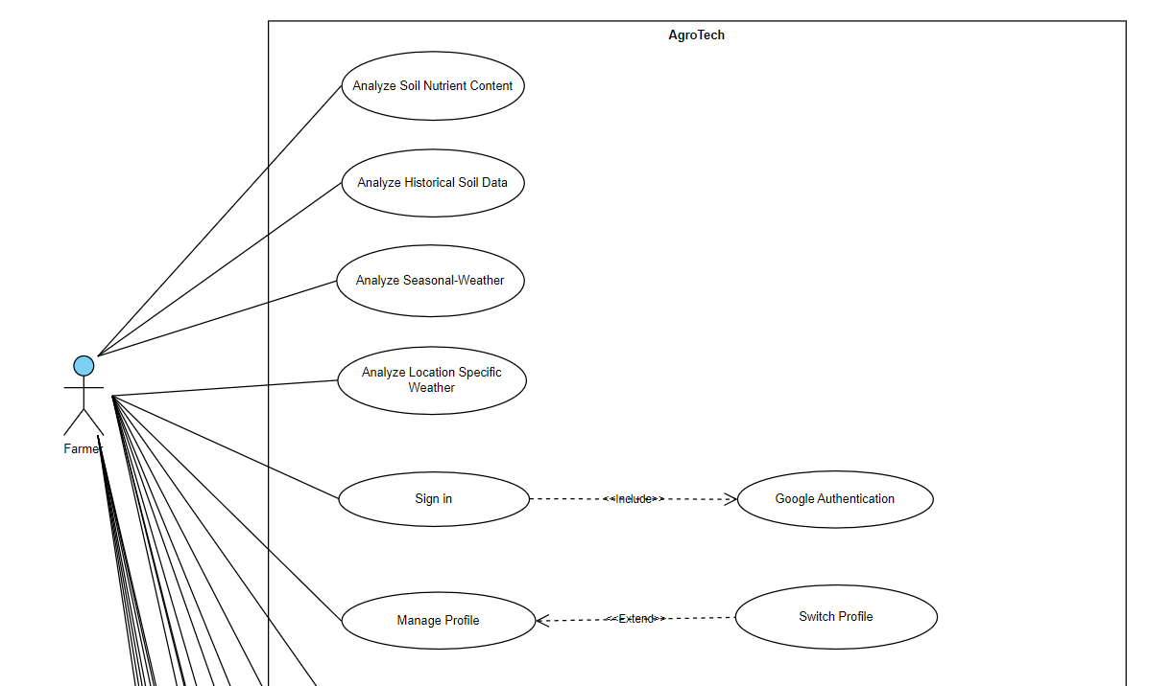
Farmer Use-Case
1

Slide 11
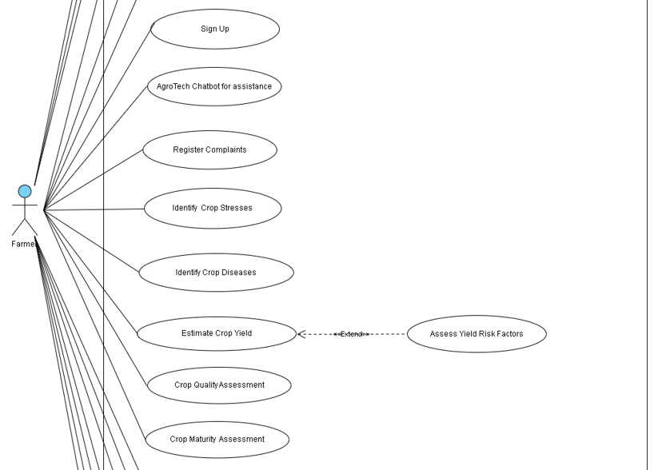
2

Slide 12
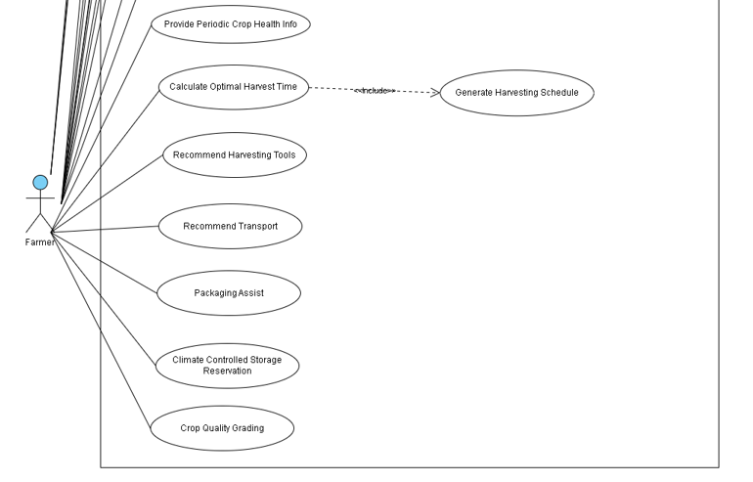
3

Slide 13
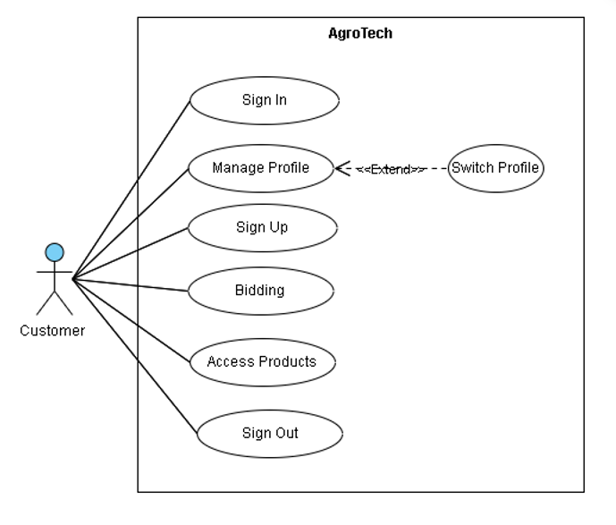
Customer Use-Case

Slide 14
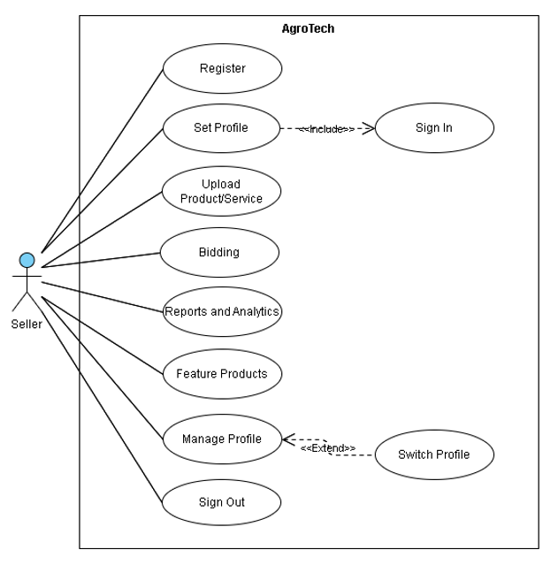
Seller Use-Case

Slide 15
Related System Analysis
Kheti-Buddy
AgroTech
It gives limited information on record keeping and crop/soil monitoring.
AgroTech will provide crop and soil monitoring using image processing and keeps detailed record of it for in-future analysis.
Crop In
Integration of comprehensive market access for farmers.
AgroTech will facilitate farmers with comprehensive market access like selling crops, pesticides and other agriculture products.
Folio3 AgTech
It gives a general purpose approach for recommendation of crops.
AgroTech will recommend suitable crops keeping in view soil type and history, climate conditions and budget.

Slide 16
Non-Functional Requirements
Reliability
Usability
System must maintain at least 85% uptime 24/7.
Fault tolerance required 95% of the time.
Most failures resolved with a hot refresh.
Full system failure may take 10-15 hours to recover depending on severity.
Responses from modules delivered in under 1 minute.
Major features accessible within 3 clicks.
User-friendly design with tooltips; users should navigate the system within 1 hour of use.
Responsive interface compatible with popular browsers (Chrome, Firefox, etc.).
Performance
Security
95% of analysis and reports generated within 5 seconds on 10 Mbps or faster connections.
Supports 1000 concurrent users without performance degradation; 2-second average response per request.
90% of chatbot queries answered within 5 seconds; 10-second maximum during peak hours.
Recent yield photos uploaded monthly.
Passwords stored using industry-standard hashing.
All client-server communication encrypted via HTTPS.
Protection against common web vulnerabilities (injection, XSS, etc.).

Slide 17
External Interface Requirements
User
Software
Use a responsive framework for desktop compatibility.
Clean, professional design with minimal colors.
Hover effects for button feedback.
Display errors in red for visibility.
Use standard icons for easy navigation.
Integrate Stripe API for payments.
Use Firebase API for social sign-ins.
Integrate third-party API for transportation module.
Implement GPT-3.5 Open API for AgroTech chatbot.
Hardware
Communication
Web-based app; no direct hardware interfaces required.
Use SMTP for emails (verification, password resets, updates).
All client-server communication via HTTPS for security.
Provide clear messages when API rate limits are exceeded.

Slide 18


